Slide 1



C# Fundamentals Exceptions

Slide 2
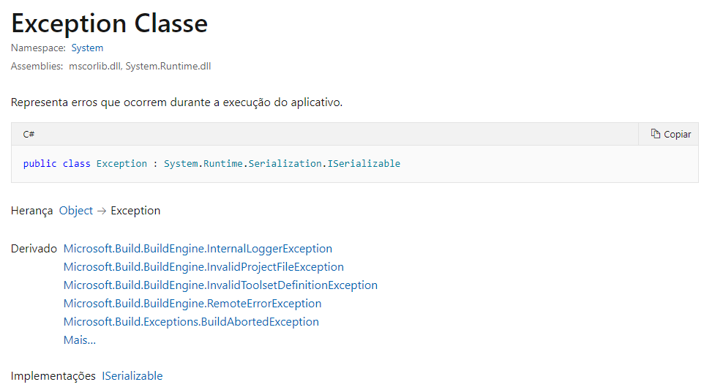
Exceptions:

Slide 3
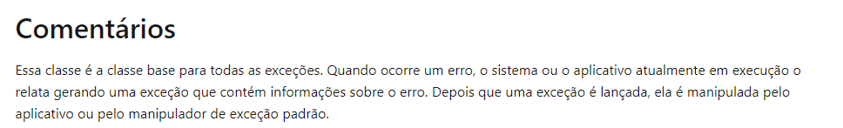
Exceptions:

Slide 4
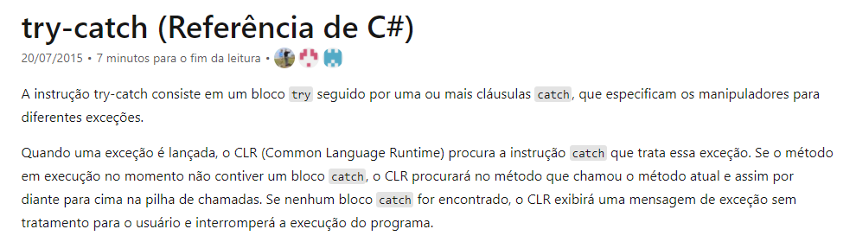
Exceptions:

Slide 5
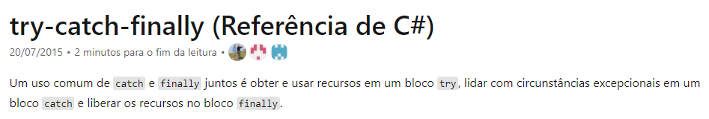
Exceptions:

Slide 6
Exceptions:
Links de documentação oficial:
Documentação:
https://docs.microsoft.com/pt-br/dotnet/api/system.exception?view=net-5.0
https://docs.microsoft.com/pt-br/dotnet/csharp/language-reference/keywords/try-catch
https://docs.microsoft.com/pt-br/dotnet/csharp/language-reference/keywords/try-catch-finally

Slide 7
Dúvidas?

